Slide 1
Group 3 – Karo Progress

Slide 2
Progress since last week
New evaluation added ( Wendy & Erik)
New Alpha Beta & Minimax ( Job & Janita )
Transposition table ( Dominik & Job)
First XNA prototype GUI for KARO (Wendy & Erik)
XNA prototype for architecture and selecting in 3D (Job)

Slide 3
To do for next review
Decide on design and architecture
Draw the board by connecting to our engine
Multithreading solution for engine or UI
Hopefully: selecting objects in 3D

Slide 4
Discussion points
Selecting objects in 3D
The use of components

Slide 5
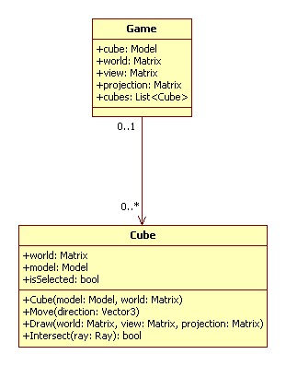
Selecting Objects in 3D
World transformations?
Issue: demonstration

Slide 6
The use of components

